Slide 1
Image processing (ce461)
Image Processing & Deep Learning Coin Sorter
“Coin Bot”

Slide 2
Computer Blindness
Yazan Ayash 20222502096
Basel Al Dwairi
20221502065
Mohammed Lafi 20229502018
Rakan Abu Najem 20229502032
Instructor Name: Dr Mahmoud Al Sarayrah Section 1 Image Processing

Slide 3
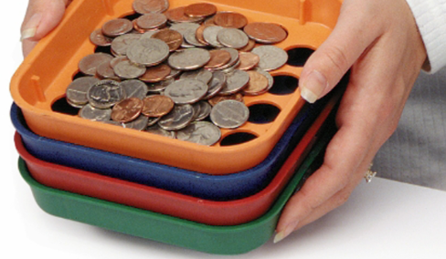
Why OUR project exists ??
Traditional coin sorting systems rely on physical properties , which become unreliable in real world conditions . Our project addresses this problem using image processing , machine and deep learning. Manual coin sorting is slow and exposed to errors so we are in actual deep need for an automated image-based solution which is way more accurate.

Slide 4
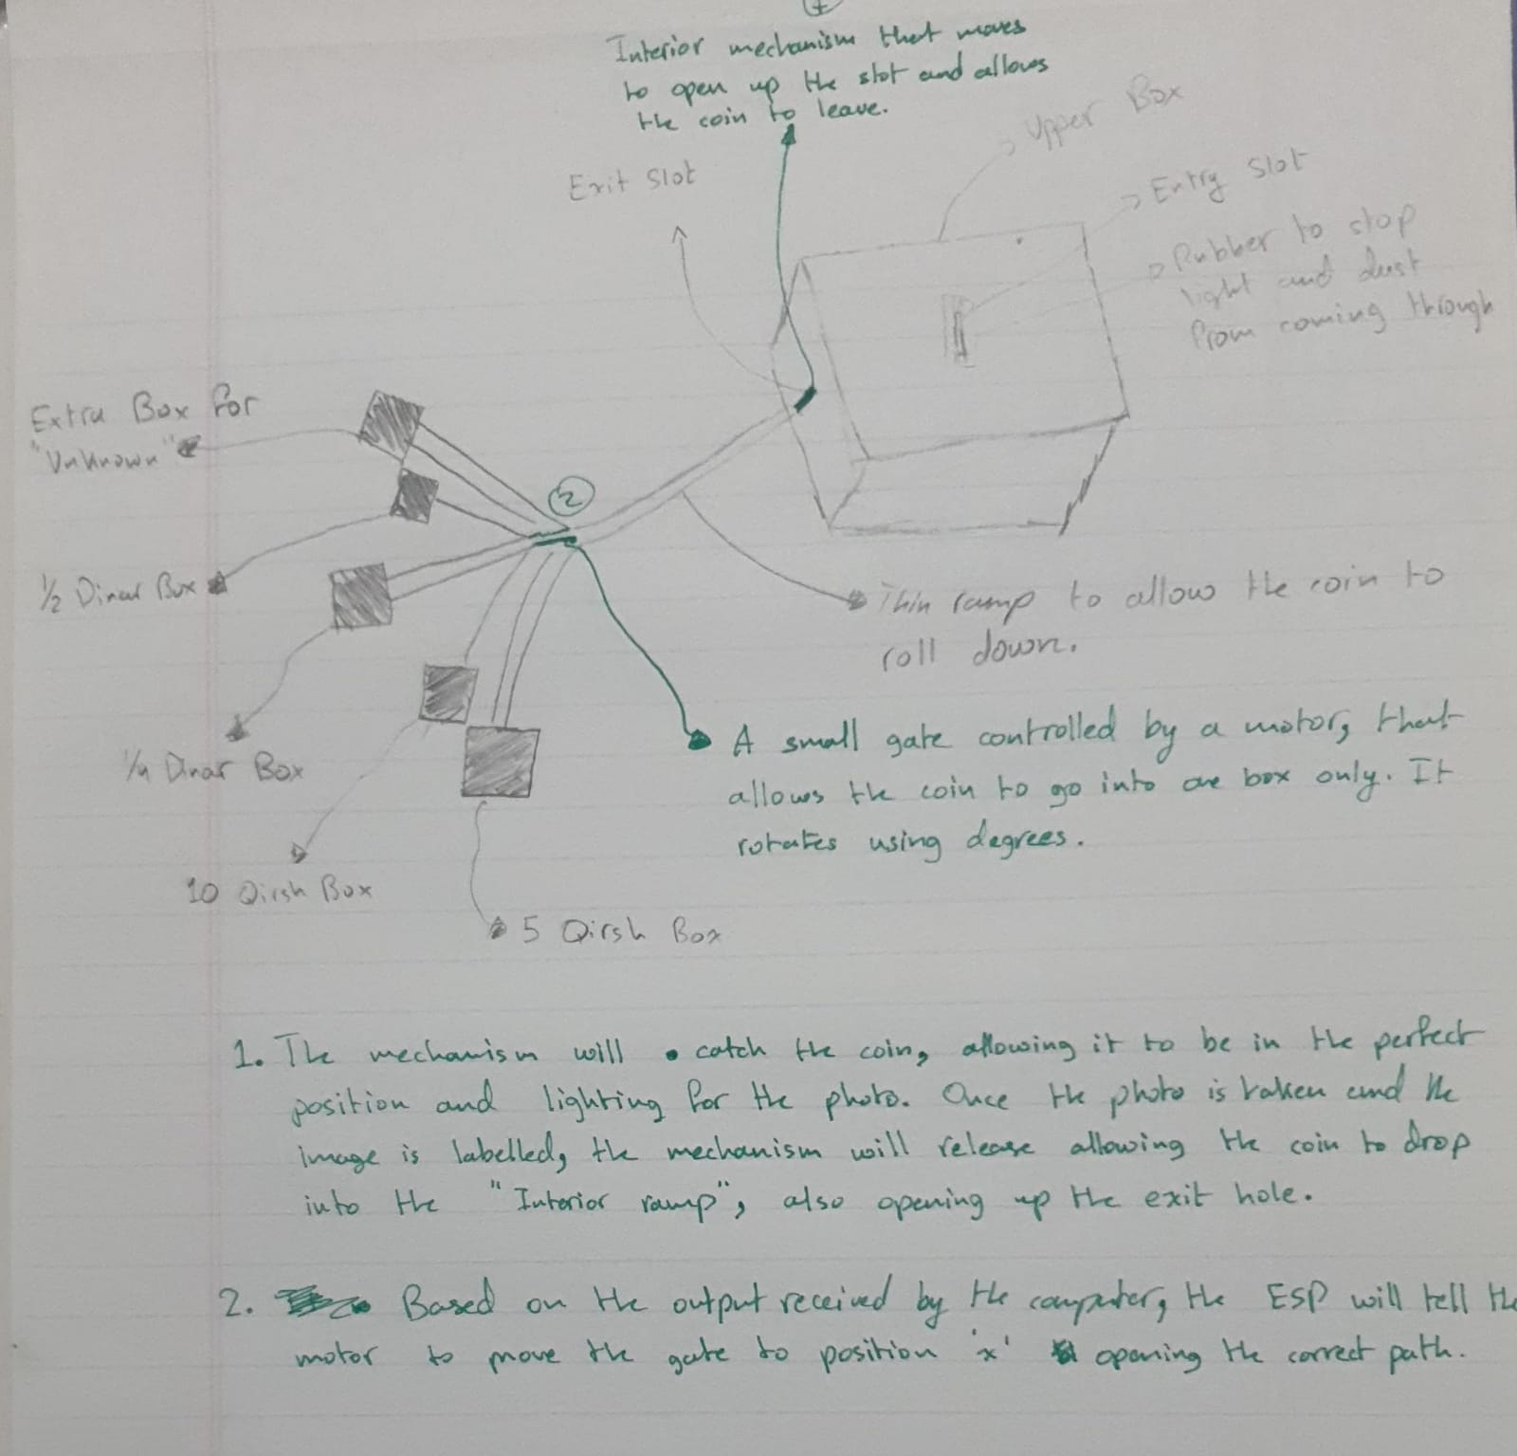
Original Design Concept

Slide 5
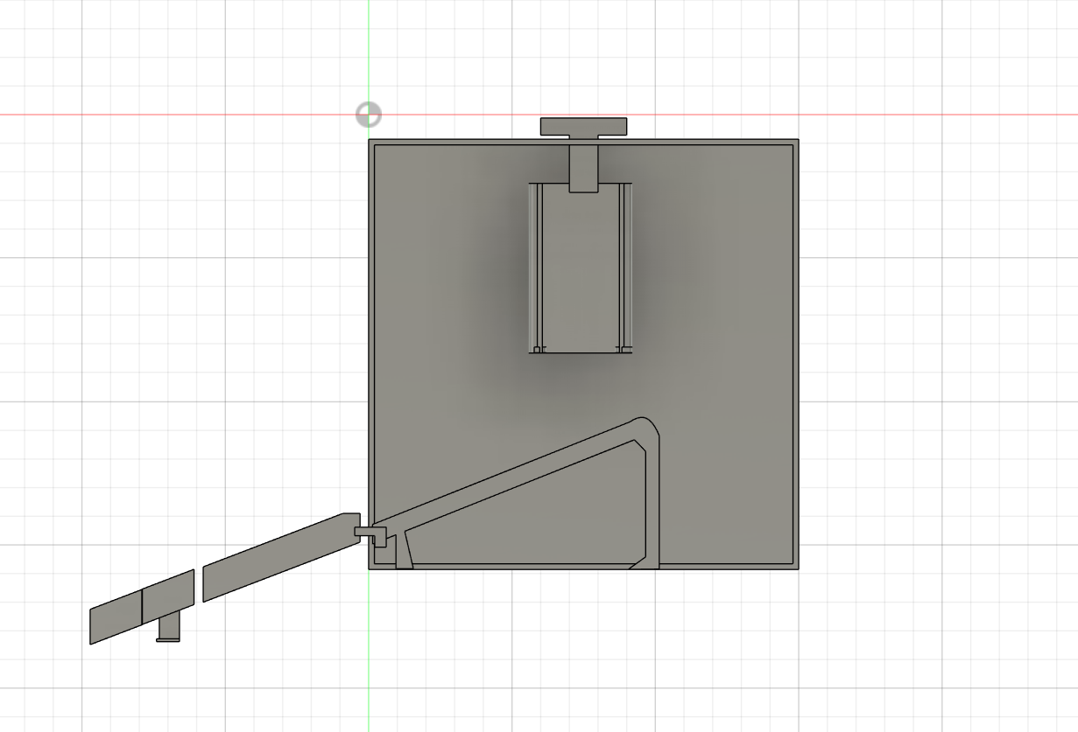
Original 3D Design

Slide 6
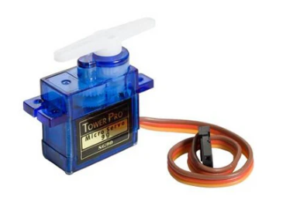
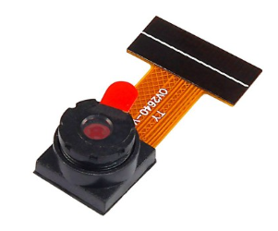
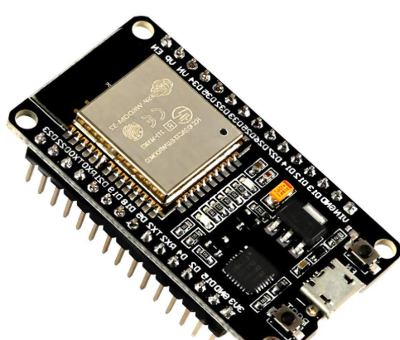
Physical Overview of coin bot
The physical prototype consists of: a box that has got the following:
An ESP32-CAM module for capturing images of inserted Jordanian coins ( 5 piasters , 10 piasters , 25 piasters and 50 piasters ).
An Infra-Red sensor is used to detect the coin insertion and cause the triggering of the image capture process.
The motors controlled are of type “Angular Servo Motor 9G” and there are 3 of them , one is attached to control the gate ( opens and closes and allows release of coin ) , the second is attached to deliver the coin it to its destined slot and the third is attached at the middle of the ramp to hold it until the previous motor decides which slot it is destined to fall on.
An ESP32 microcontroller responsible for sensor reading , communication , and motor control and they are all connected using wires , and resistors are used to add resistance to maintain the sensors’ and motors’ statuses and prevent them from getting damaged.

Slide 7
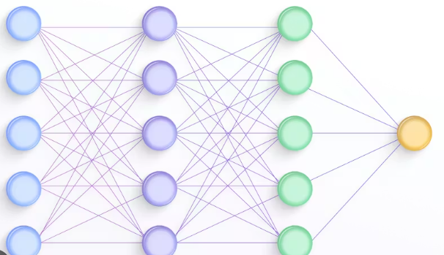

SOFTWARE & MODEL OVERVIEW OF COIN BOT
The Software and model consist of:
A Python-based image processing pipeline for preprocessing captured coin images from a single dataset.
A convolutional neural network (CNN) built using TensorFlow and trained with transfer learning.
A MobileNetV2 pre-trained model , frozen during training and fine tuned for Jordanian coin classification.
TCP/IP socket communication code to handle image transfer and classification results between the ESP32 , ESP32-CAM , and the host machine, reliably.
A Streamlit-based user interface used to test and validate the model using local and web images, and a prototype for segmenting coins from images.

Slide 8
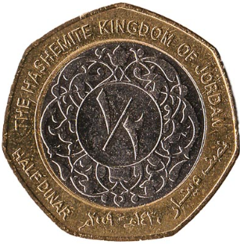

Why image processing ?
Segment and Crop Coins individually
Normalizes image size
CNN extracts meaningful features for classification
Improves robustness before deep learning process

Slide 9
Dataset overview
Dataset contains images of different Jordanian coin denominations
images show coins under different:
Lighting conditions
Angles
Backgrounds
and the data is labeled as:
½ dinar
¼ dinar
10 piasters
5 piasters

Slide 10

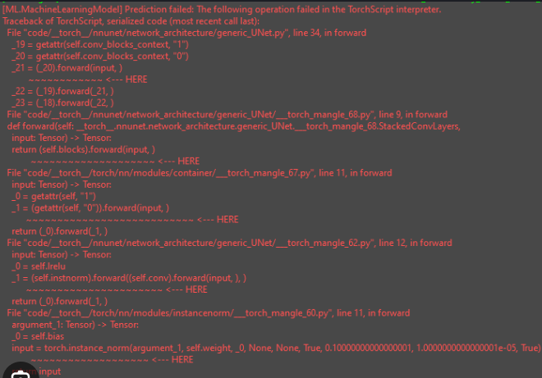
Dataset challenges
Images contained multiple coins in a single frame.
Presence of irrelevant objects such as banknotes.
Inconsistent lighting and backgrounds.
Variations in coin orientation , scale and rotation.
Images were not suitable for direct image analysis .

Slide 11
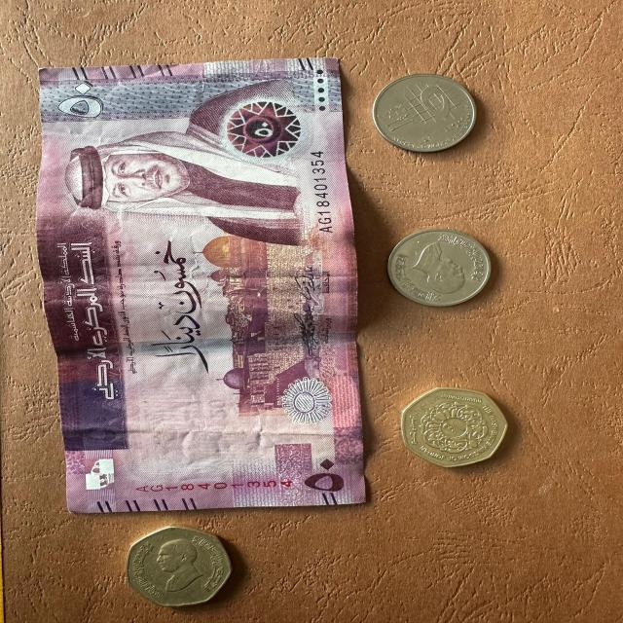




Dataset challenges

Slide 12
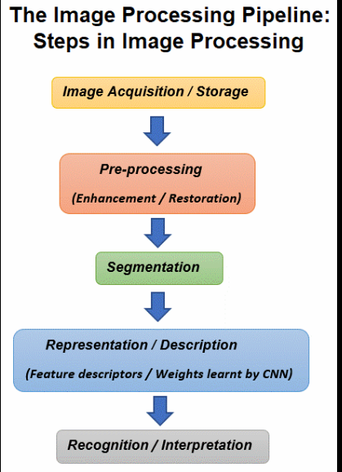

HOW THOSE CHALLENGES WERE OVERCOME
Image Preprocessing Pipeline : The following image preprocessing methods were used on the images:
Detected Coins, used annotations of the dataset, Image detection and segmentation proved inefficient
Cropped individual coins from images in dataset containing multiple coins.
Removed irrelevant classes to keep only coin denominations.
Normalized image sizes to 224 x 224 RGB for CNN compatibility.
Standardized image format.

Slide 13
Image system overview
Image classification
Image segmentation

Slide 14
CNN model architecture
Input (224 x 224 x 3)
preprocess_input
MobileNetV2 (Feature extraction)
MobileNetV2 is a fast, lightweight CNN that uses inverted residual blocks and depthwise separable convolutions to give high accuracy with very low computation, making it ideal as a backbone of the model.
GlobalAvgPool2D
Dense( 128, relu activation)
Dense( 4, softmax activation)
This is shown in the code snippets in the upcoming slides.

Slide 15
NEURONS , FILTER AND POOLING
Input Image
Pre-process Input Layer
MobileNetv2 Base
GlobalAvgPooling2D
Output
4
Softmax
Dense
128
ReLU

Slide 16
Feature EXTRACTION
Images pass through convolution layers
Filters detect:
1. Edges
2. Texture
3. Shapes
Feature maps highlight important regions
Extracted features used for classification

Slide 17
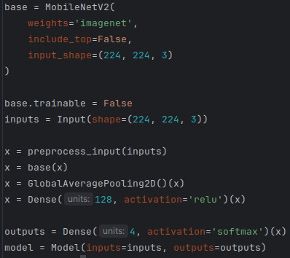
CNN architecture

Slide 18
TRANSFER LEARNING APPROACH
Transfer learning was applied by fine-tuning a pre-trained CNN (MobileNetV2) for coin classification. The base model was frozen while additional layers were trained , reducing training time and improving accuracy with limited data .
This achieves high accuracy with limited training while significantly reducing training time and over fitting .

Slide 19
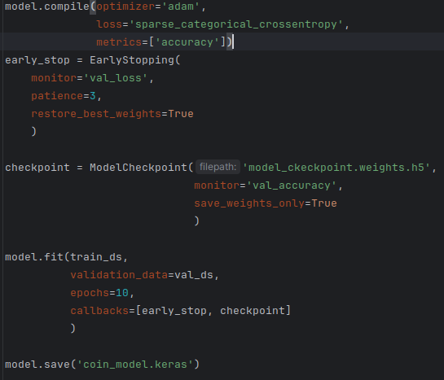
Training configuration
Optimizer: Adam
Training Rate: 0.001
Loss : sparse categorical cross-entropy
Monitor metrics: Accuracy
Callbacks: Early-stopping, model checkpoint
Dataset split: 80% train, 20% validation

Slide 20
Label Smoothing (Softmax)
Label smoothing is a regularization technique used to prevent the model from becoming overconfident in its predictions. Instead of assigning a probability of 1 to the correct class and 0 to others, small values are distributed across all classes. This helps improve generalization and reduces overfitting.
Why it is useful
Prevents extreme confidence in predictions
Improves model generalization
Reduces overfitting
Makes training more stable

Slide 21
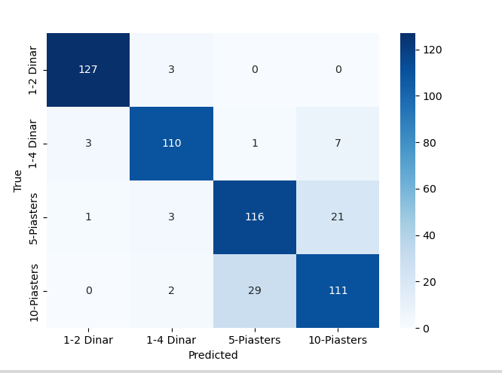
Model ACCURACY
The model achieved an
accuracy of around 0.98 on
training and 0.88 on validation

Slide 22
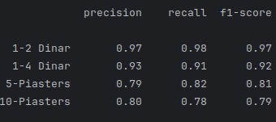
Accuracy vs recall

Slide 23
Segmentation Pipeline
Input Image
Convert to Gray scale
Gaussian Blur
(3,3) kernel
Edge detection (Canny, 50,150)
Morphological Closing
(5,5)
Ellipse Kernel
Contours
Contour filtering:
Area, Perimeter, Circularity
Bounding Boxes for contours
Crop each coin individually
Classify each coin individually

Slide 24
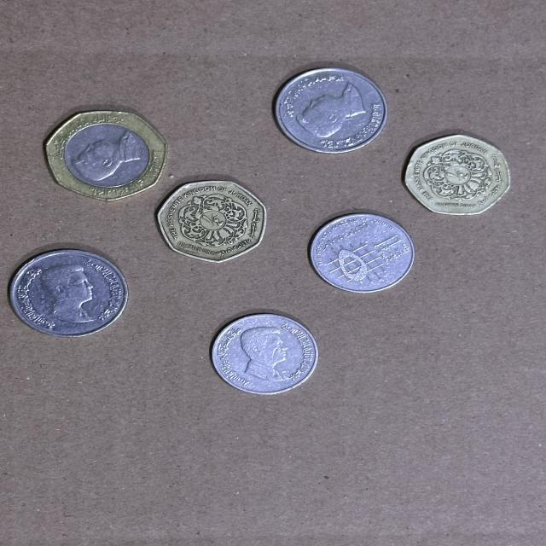
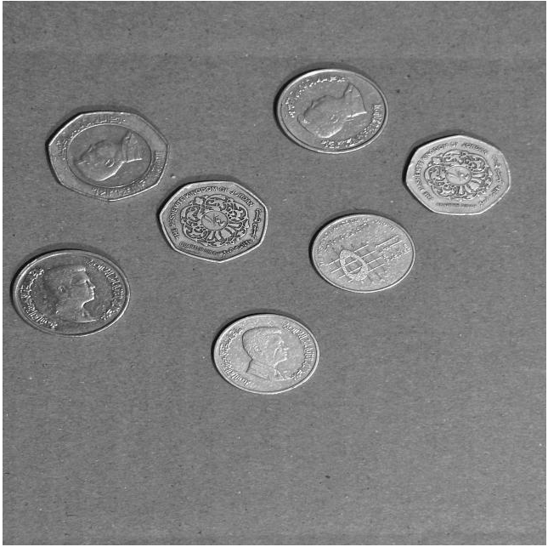
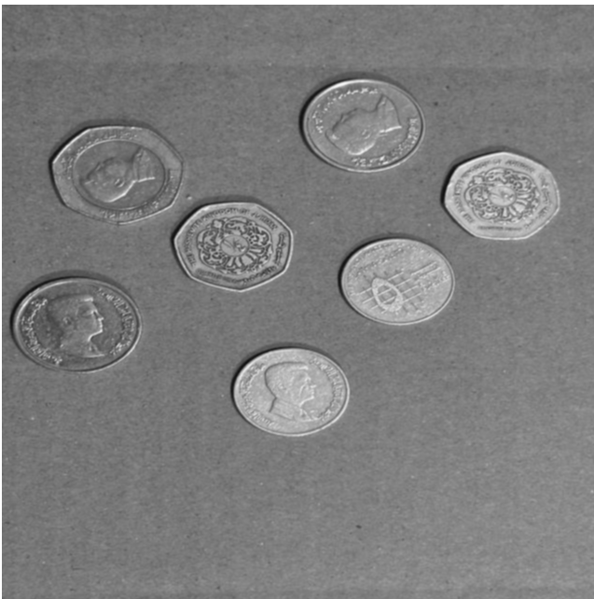
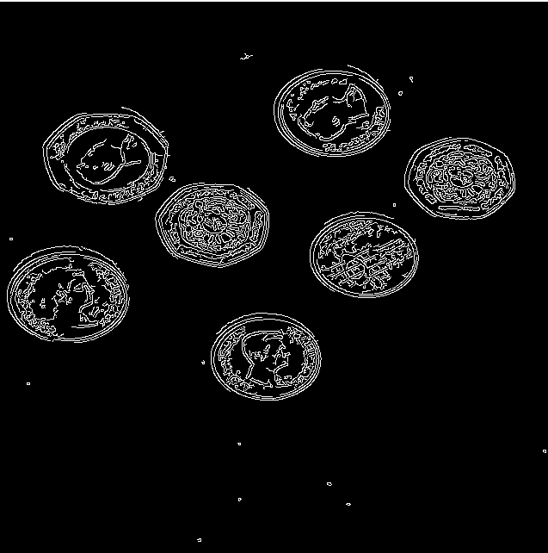
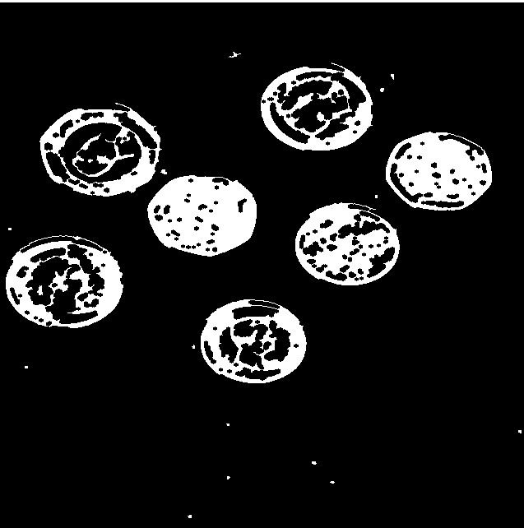

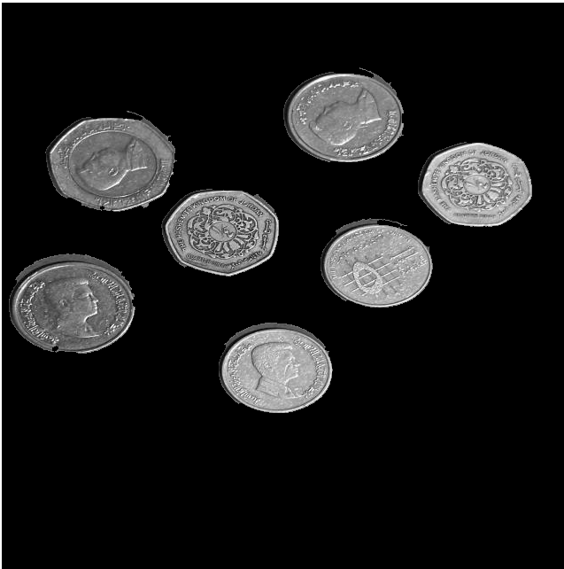

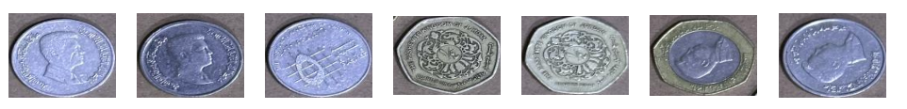
Segmentation Pipeline

Slide 25
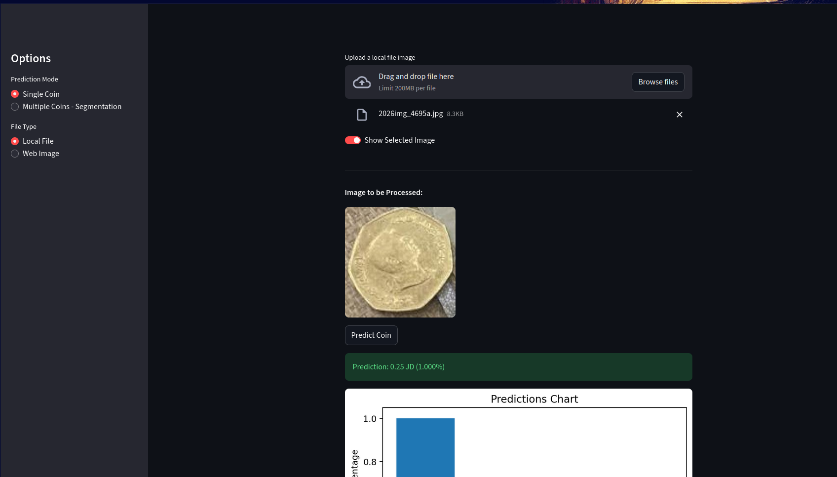
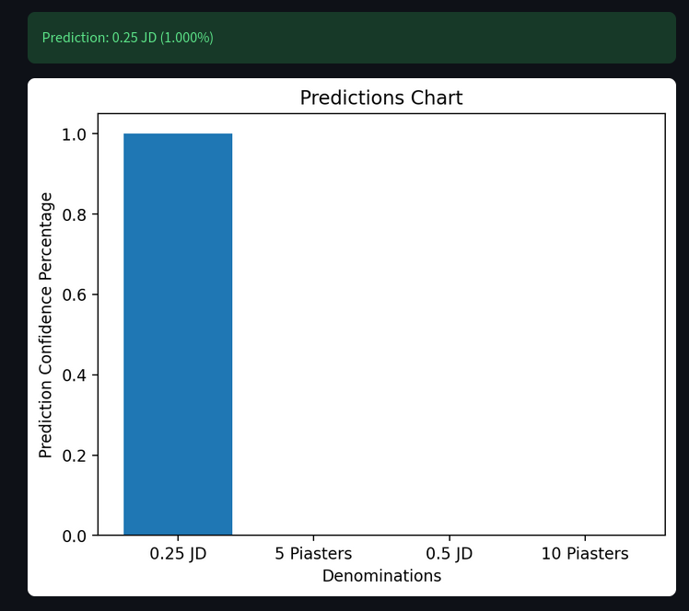
Single coin MODEL TESTING & UI (STREAMLIT)

Slide 26
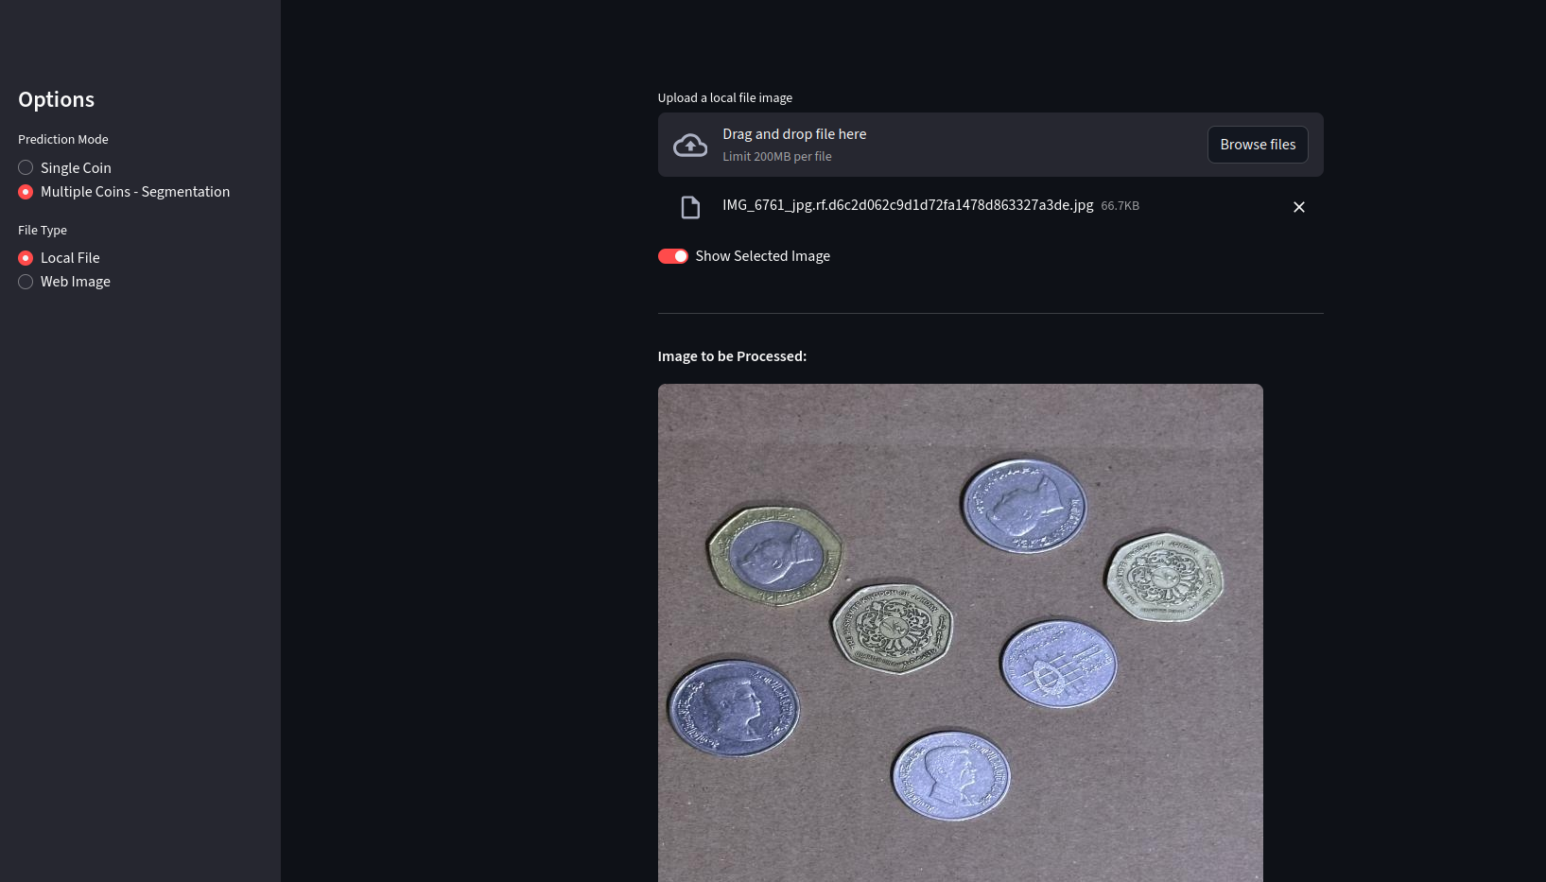
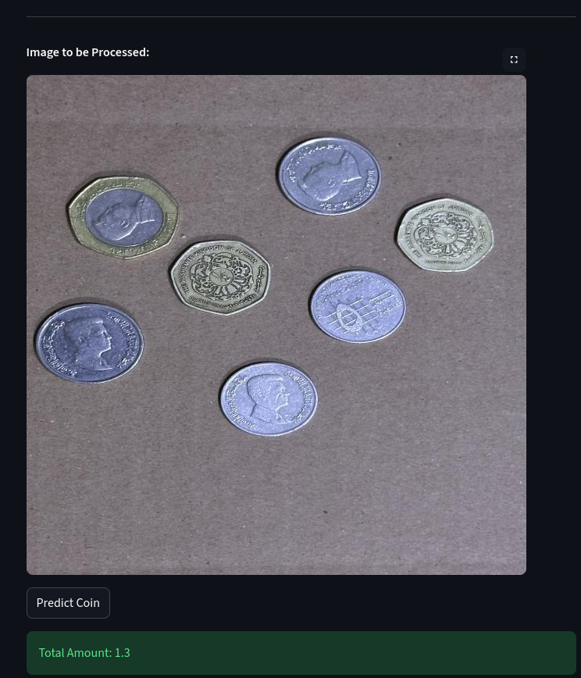
Multi coin Segmentation TESTING & UI (STREAMLIT)

Slide 27
Grayscale (Experimented Step)
Converted images to grayscale during classification+
Reduced image complexity
Enhanced edge visibility
Compared Grayscale vs RGB performance
Color was a strong feature for classification
RGB performed better → final model kept color channels

Slide 28
Mechanical system overview
The mechanical system translates CNN predictions into physical coin sorting
Composed of interior and exterior subsystems

Slide 29
Interior design overview
Interior ramp mechanism
Infra-Red sensor placement
Interior gate mechanism
Camera alignment zone

Slide 30
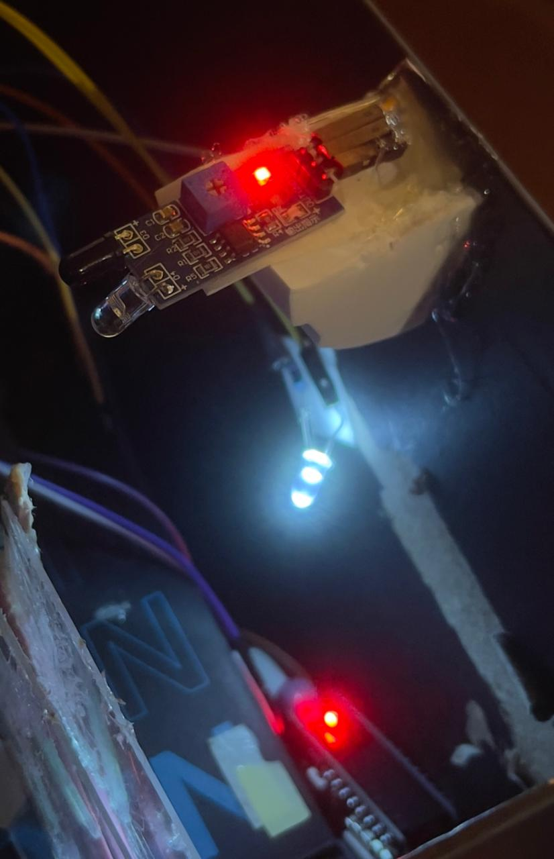
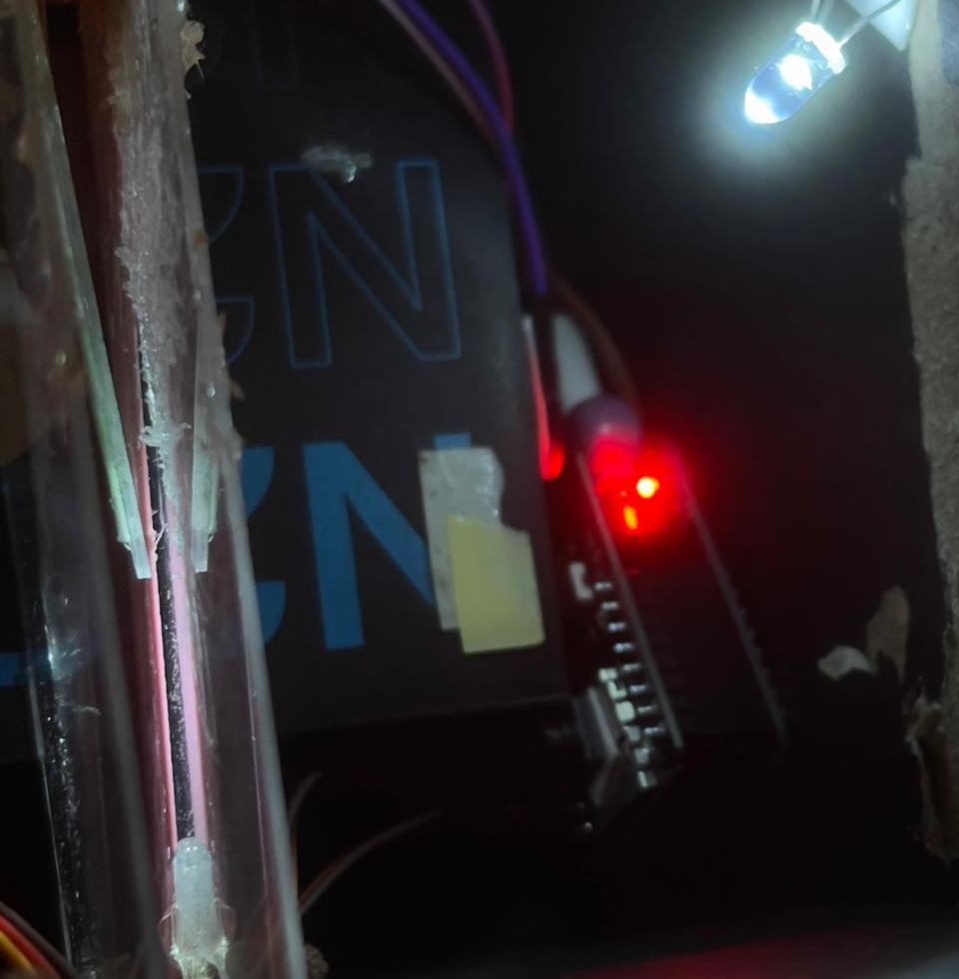
Interior: Coin detection & Imaging
IR sensor detects coin insertion
Coin is held stationary for image capture
ESP32-CAM captures a clear top-down image

Slide 31
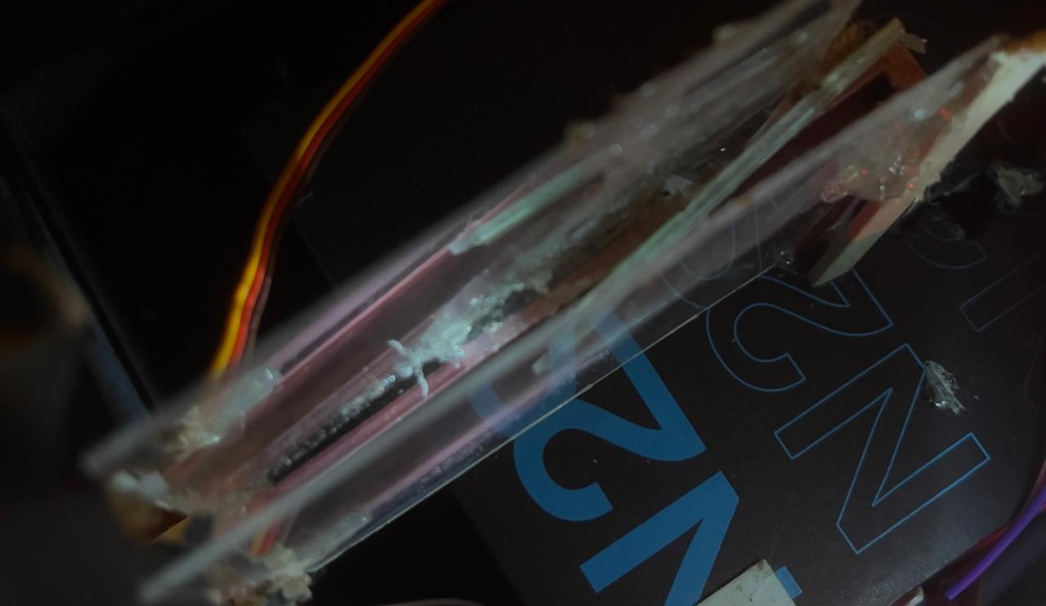
Interior: holding gate & interior ramp
Motor-controlled holding gate
Prevents motion blur during imaging
Releasing coin only after classification

Slide 32
Interior → Exterior
Coin released after CNN prediction
Classification result determines sorting path
Control signal sent to exterior system

Slide 33
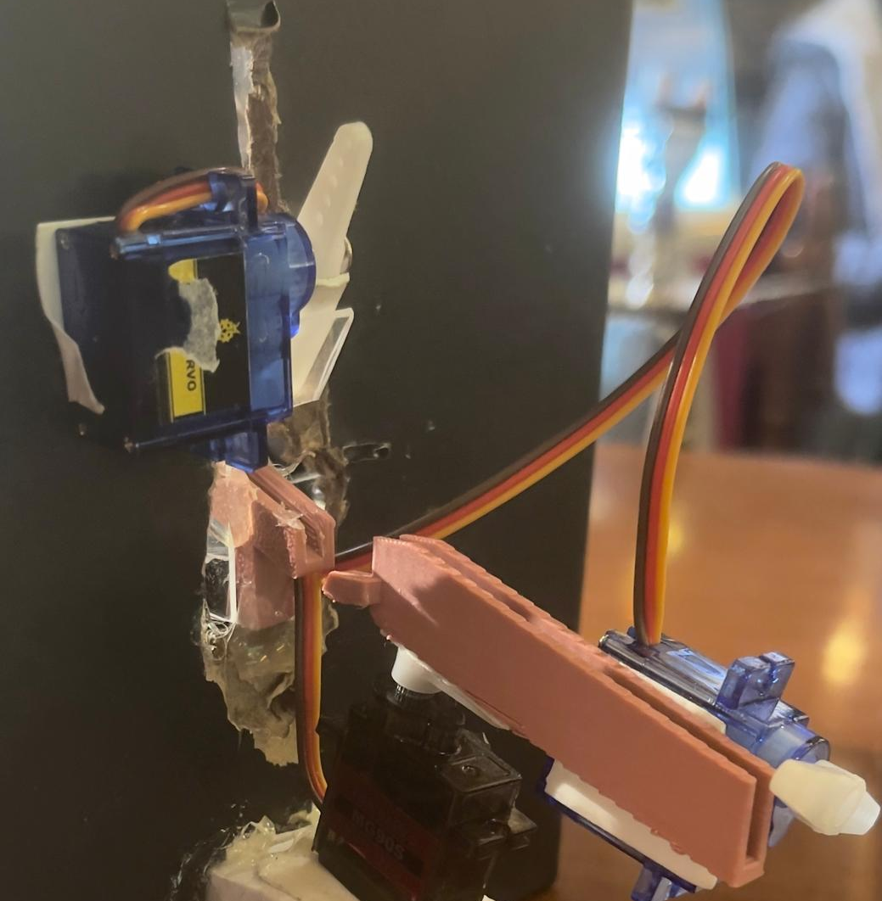
EXTERIOR DESIGN OVERVIEW
Exterior ramp system
Servo-controlled gates
Multiple output slots for denominations

Slide 34
CALIBRATION & RELIABILITY
Motor tuning for precise angles
Tuning calibration between gates
Achieved ~90% correct physical sorting

Slide 35
Exterior: sorting mechanism
Servo positions correspond to coin classes
Ramp angle directs coin to correct slot
Gates open and reset after each cycle

Slide 36
INTERIOR VS EXTERIOR
Interior
Exterior
IR sensor + camera
Detection & imaging
Image stability
Ramps & gates
Coin delivery
Physical sorting

Slide 37
Limitations & future work
Limitations
Future Work
Limited dataset size affects model generalization.
Sorting accuracy is influenced by mechanical stability.
Image classification is performed on a host machine , not on-device.
Expand the dataset to improve robustness.
Deploy the CNN directly on embedded hardware (edge AI).
Improve mechanical design to reduce mis-sorting.
Extend the system to support additional currencies.

Slide 38

CONCLUSION
This project developed an automated coin sorting system that integrates image processing, deep learning, and embedded system control. A convolutional neural network was used to accurately classify Jordanian coins, while sensor-triggered image capture and motor-driven mechanisms enabled reliable physical sorting. The results demonstrate the effectiveness of deep learning in real-world applications and highlight the successful integration of intelligent software with hardware systems.

